Slide 1
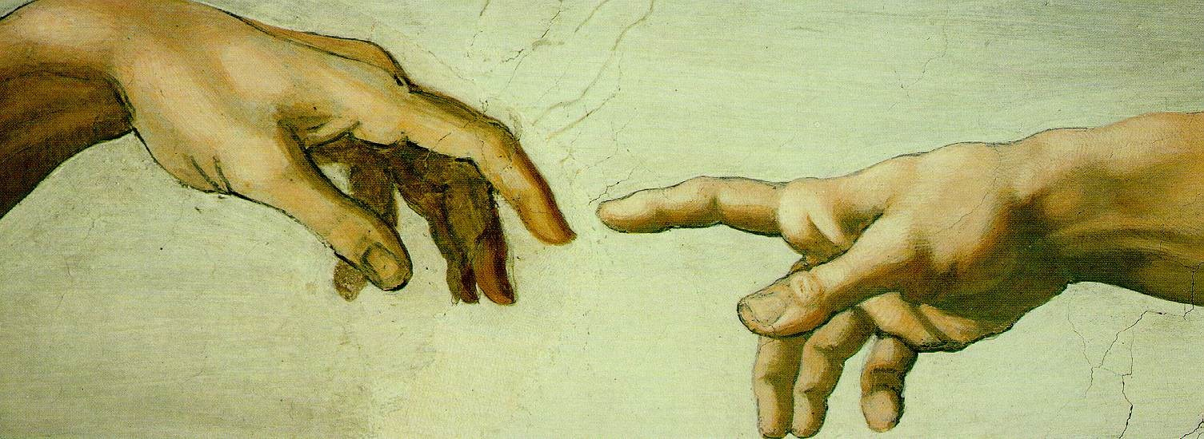
Certificate IV in Christian
Ministry and Theology
(30772QLD)
partnering with churches in developing
and equipping believers for mission and ministry
2013 - Term 1
Introduction to Theology 1.00pm Tuesdays
8 weeks, classes commence 12 Feb Dr Bill Berends
Critical Knowledge Online Course
Tutorial held 7pm, 19 February Dr Phillip Scheepers
A Taste of Israel (Non-Cert IV unit) 7.00pm Tuesdays
4 weeks, classes commence 26 Feb Alvin Johnson
for further information and enrolment details, contact SOLA:
info@solamc.org or 5244 3952
Sola Ministry College is a part of
the Australian College of Ministries
(ACOM) training network - RTO #90965

